Slide 1
Building Basic Calculator using Python
Presented by Neetha B J
15th February 2026

Slide 2
introduction
Python is a popular Programming Language. It is used for:
Web development(server side)
Software development
Mathematics
System Scripting

Slide 3
Python programming language is very well suited for beginners, also for experienced programmers with other programming languages like C++ and Java. The biggest strength of python is huge collection of standard libraries which can be used for the following GUI applications.(like kivy, Tkinter, PyQt etc.)
Machine learning
Web framework
Image processing
Web scraping
Test Frameworks
Multimedia
Scientific Computing
Text Processing and many more…

Slide 4
ABOUT THE PROJECT
A calculator is basically a program on a computer that simulates the behaviour of any hand-held calculator useful for performing Mathematica calculations. It is a very basic device used in our everyday lives. Now all the smartphones also have a Calculator application in them.
While creating any GUI Application there are mainly two steps:
The first step is to create a User Interface.
The second step is the most important one and in this, to add functionalities to the GUI.

Slide 5
TOOLS AND TECHNOLOGIES
Tools – Python
Python Libraries – Tkinter, etc
Tkinter – Tkinter is the standard GUI library for Python. Python when combined with Tkinter provides a fast and easy way to create GUI applications. Tkinter provides a powerful object-oriented interface to the Tk GUI toolkit.

Slide 6
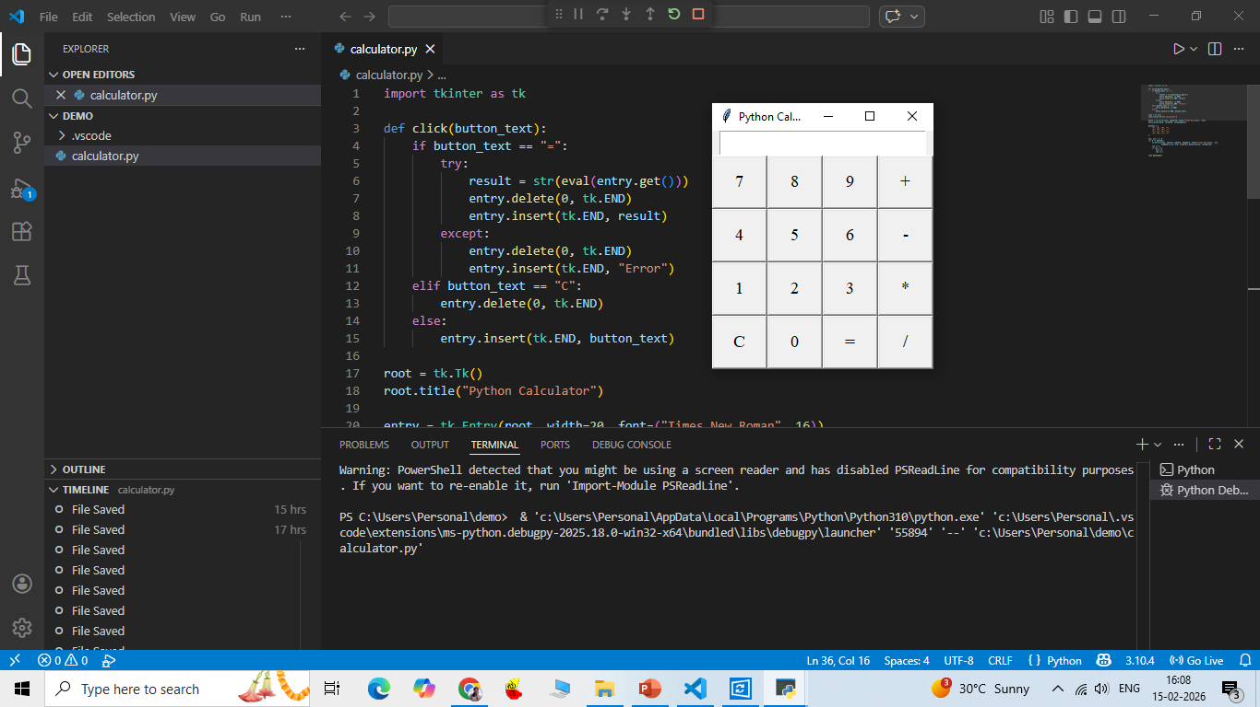

Slide 7
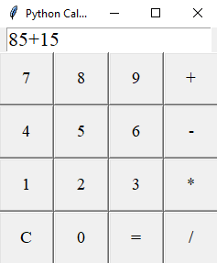
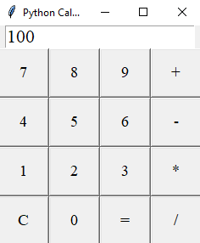
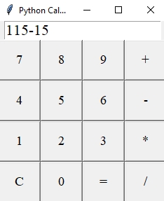
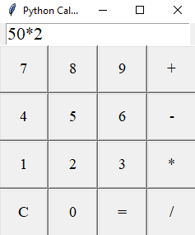
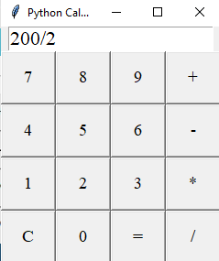
ADDITION ( + )
SUBTRACTION ( - )
MULTIPLICATION ( * )
DIVISION ( / )

Slide 8
Thank you

